Slide 1

CS 4320 Midterm Presentation
Team 7: Rayne Guinta, Jeffrey Simonoff, and Jessie Meredeth
CS 4320 Sec. 1
DR. Armin Moin
TA Aryan Padiyal
CC0 1.0
CC0 1.0 Universal
Permission to be published on UCCS website

Slide 2
Project
Topic: Railway Train Booking System and Tracking
Path: Plan Driven
Description: This is a Greenfield Project focused on checking the attendance of passengers that have purchased a ticket.
Who: Train Transport Companies, Staff, and Passengers
Problem: Insufficient visibility on passenger attendance, leading to issues such as overbooking and unaccounted passengers.

Slide 3
License - Open-source
MIT License Copyright (c) [2024] [Rayne Guinta, Jeffrey Simonoff, Jessie Meredeth] Permission is hereby granted, free of charge, to any person obtaining a copy of this software and associated documentation files (the "Software"), to deal in the Software without restriction, including without limitation the rights to use, copy, modify, merge, publish, distribute, sublicense, and/or sell copies of the Software, and to permit persons to whom the Software is furnished to do so, subject to the following conditions: The above copyright notice and this permission notice shall be included in all copies or substantial portions of the Software. THE SOFTWARE IS PROVIDED "AS IS", WITHOUT WARRANTY OF ANY KIND, EXPRESS OR IMPLIED, INCLUDING BUT NOT LIMITED TO THE WARRANTIES OF MERCHANTABILITY, FITNESS FOR A PARTICULAR PURPOSE, AND NONINFRINGEMENT. IN NO EVENT SHALL THE AUTHORS OR COPYRIGHT HOLDERS BE LIABLE FOR ANY CLAIM, DAMAGES OR OTHER LIABILITY, WHETHER IN AN ACTION OF CONTRACT, TORT OR OTHERWISE, ARISING FROM, OUT OF OR IN CONNECTION WITH THE SOFTWARE OR THE USE OR OTHER DEALINGS IN THE SOFTWARE.

Slide 4
Related work
Aviation Tracking Systems
Ship and Ferry Tracking Systems
Public Transit
Real-Time Transit Apps(Google/Apple Maps)

Slide 5
Unique Selling Point (USP)
The unique selling point of our project is the real-time tracking of both passengers and crew members. It will have real-time geolocation, emergency management, and security-focuses access control for trains specifically.

Slide 6
Options to Build Upon
GPS for Train Tracking
Wi-Fi and Bluetooth Beacons(Apple iBeacon and Google Eddystone)
Open Trip Planner and General Transit Feed Specification
OpenCV(Security)
Cloud Infrastructure(AWS IoT or Google Cloud IoT)
Why Not Reuse?
Proprietary Systems
Limited Focus Solutions
Limited Flexibility

Slide 7
Use Cases
UC-1: Login
Description: Use an algorithm to check whether the user is a customer or staff member, as well as if the user's account exists. If so, the user will be redirected to a landing page.
UC-2: Monitor Network Status
Description: Use an algorithm to check the network's overall status. If the network is down for any reason, a technician should be contacted to sort out these issues.
UC-3: Check Seating Availability
Description: Utilize a data-focused algorithm to check for available seats. If the seat has been taken by another user, the seat will not be selectable by another user unless that user is a staff member.
UC-4: Payment Processing
Description: Use a data-processing algorithm to interpret a user customer's payment methods, where contact between the user's bank account and the company's system will act as a key factor to process the customer's payment to the company.
UC-5: Assign Passenger Seating
Description: Upon selecting a seat, a customer's account will be attributed to the selected seat, where the data will be stored in a data-focused algorithm.
UC-6: Train Tracking
Description: Utilize tracking hardware and software to examine what trains are available within a platform. If a train is in an emergency, nearby platform operatives or emergency services will be informed about the issue that has occurred.

Slide 8
Quality Attributes/Non-Functional Requirements
QA-1: Security
Attributed Use Cases: UC-1 (Login), UC-4 (Payment Processing)
Description: The system must ensure secure user authentication and protect sensitive user data (customer/staff identification, login credentials, payment details).
QA-2: Performance
Attributed Use Cases: UC-1 (Login), UC-3 (Check Seating Availability), UC-4 (Payment Processing)
Description: User login and seating availability checks should be completed in real-time or within milliseconds. Payment processing should occur promptly, with minimal latency when connecting with banks or processing transactions.
QA-3: Availability
Attributed Use Cases: UC-2 (Monitor Network Status)
Description: The system must have high uptime, especially for network monitoring, with fast detection of network outages.
QA-4: Reliability
Attributed Use Cases: UC-2 (Monitor Network Status), UC-3 (Check Seating Availability)
Description: The system should consistently monitor the network and seating availability, detecting any failures and providing notifications for resolution.

Slide 9
Concerns and Restraints
CRN-1: User Authentication
Description: Proper authentication processes are crucial to distinguish between customers and staff. Weak authentication may lead to unauthorized access to sensitive areas of the system.
CRN-2: Network Dependency
Description: The system's reliance on network connectivity for features like monitoring and payment processing raises concerns about what happens during network outages or disruptions.
CON-1: User Training and Support
Description: Staff and customers may require training to effectively use the system. Lack of adequate training could lead to misuse or failure to utilize system features.
CON-2: Budget Limitations
Description: Financial constraints may limit the resources available for system development, maintenance, and upgrades, potentially affecting performance and security.

Slide 10
1st Iteration
Redefine Design Purpose.
Safety and Security: Real-Time Tracking, Emergency Management, and Access Control
Passenger Experience: Seat preferences/Selection

Slide 11
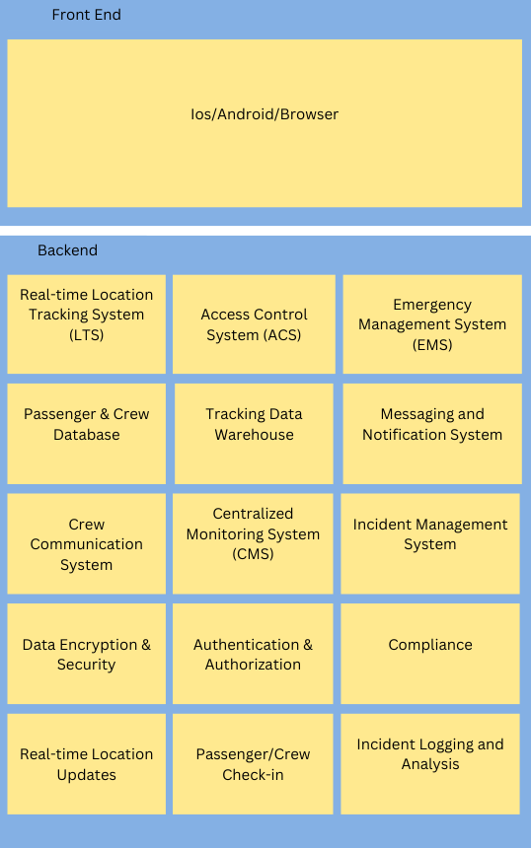
1st Iteration
Choose one or more design concepts that satisfy the selected driver(s).
Concept: Reference Architecture-

Slide 12
1st Iteration
Design Decision 1: GPS and Bluetooth Beacons
Rationale: GPS is highly effective for tracking objects outdoors, but GPS by itself is not effective inside the train due to poor signal. To fix this each train company should install Bluetooth beacons in the carriages to have precise positioning.
Design Decision 2: Decentralized Cloud-Based Data Storage and Processing
Rationale: Allows real-time data from GPS and Bluetooth to be processed and stored in multiple accessible locations, consisting of passenger, platform, and train-focused servers.
Design Decision 3: Data Privacy Protocols
Rationale: Minimizing data access, by implementing a Role-Based Access Control.

Slide 13
1st Iteration
Element | Responsibility
Presentation Client Side | This layer contains modules that control user interaction and use case control flow.
API Gateway | Manages requests from clients, routing them to appropriate microservices while providing a single-entry point.
User Authentication Module | Handles user registration, login, and token management to ensure secure access to the system.
Train Attendance Microservice | Manages attendance records, including check-ins and check-outs, providing CRUD operations for users.
Decentralized Data Storage | Uses a distributed ledger or decentralized database to store attendance data securely and transparently.
Notification System | Sends alerts and notifications to users regarding attendance updates or reminders via email or push notifications.
Analytics Engine | Gathers data from attendance records to generate insights and reports for users and administrators.
Admin Dashboard | Provides administrative tools for managing users, viewing attendance metrics, and system health monitoring.
Integrations Module | Facilitates connections to third-party services, such as calendar apps or transport systems for enhanced user experience.
Security Layer | Ensures data encryption, secure communication, and protection against common vulnerabilities.
Passenger Server | Handles passenger application module to operate client(passenger)-server communications, including ticket storage.
Train Server | Handles train staff client-server communications, including passenger records. Communicates to the passenger and operative servers.
Operative Server | Handles platform operative client-server communications, often communicating with the train server on passenger capacity.
Recorded Design Decisions
Main contributing factors
Decentralized Server Coordination
Data collection of passenger and staff attendance
Communications between passenger, platform operative, and train staff servers

Slide 14
1st Iteration
Not Addressed | Partially Addressed | Completely Addressed | Design Decisions Made During the Iteration
 | UC-1 |  | Separate user roles between passenger and staff have been identified. Login functionality is utilized in selected related work.
 | UC-2 |  | Selected technologies through related work and backend systems address this use case.
UC-3 |  |  | No relevant decisions made as it is vital to examine what systems will be utilized.
UC-4 |  |  | No relevant decisions made as it is important to address how communications and technologies will be used with payment processors.
 | UC-5 |  | Selected reference architecture supports modules that can utilize this functionality.
 | QA-1 |  | Separate user roles in login have been addressed, but payment processing has yet to be implemented.
 | QA-2 |  | Login has been addressed, but not payment processing or seating availability
 | QA-3 |  | Selected backend system technologies acknowledge this attribute.
 | QA-4 |  | Network status monitoring has been partially addressed with this attribute, while payment processing still requires a decision.
CRN-1 |  |  | No relevant decisions made.
 | CRN-2 |  | A decentralized server algorithm ensures the security of some data that passengers and staff may have had access to while online. Additionally, there will be dedicated staff for each server.
 | CON-1 |  | Concern is partially addressed through the idea of a proper UI, which will allow passenger and staff users to utilize the system in a simple but efficient manner. The technology will be open source to address the issue of a user interface. Training will allow for smoother processes between all users.
CON-2 |  |  | No relevant decisions made.
Considered Factors
Our Progress on Addressing:
Use Cases
Quality Attributes
Concerns
Restraints
Our Current Decisions
What's Confirmed?
What's Still Developing
What has not been contributed to yet?

Slide 15
Work Breakdown
Rayne
Conceptual Data Sketches
Architectural View and Viewpoint Sketches
Documented Views and Viewpoints
Jeffrey
Initial Idea
Element and Responsibilities Chart
Table Iterations in Documentation
Jessie
Communications and Planning
Design Decisions
Decision and Iteration Flows in Documentation

Slide 16
Diagrams and Related work(Design documentation)
UML activity diagram
Behavioral Viewpoint
CONCEPTUAL MODEL FOR VIEWS AND VIEW COMPONENTS
Block diagram

Slide 17
Dedicate one slide to show the relationship between your project and the course content explicitly.
Our project goes hand and hand with scenario 1 from lab 1, which is the greenfield project in a well understood domain.
A system to track passengers is nothing new, in fact, it’s a well explored topic, but our system allows for more effective tracking than other systems. For this reason, our project similarly relates to scenario 1 from lab 1.

